Slide 1
10 Lessons of Leadership & Wearing the White Hat
Referee Essentials

Slide 2
READ YOUR RULE BOOKS AND STUDY THE MECHANICS FOR THE POSITION YOU ARE ASSIGNED TO WORK.

Slide 3
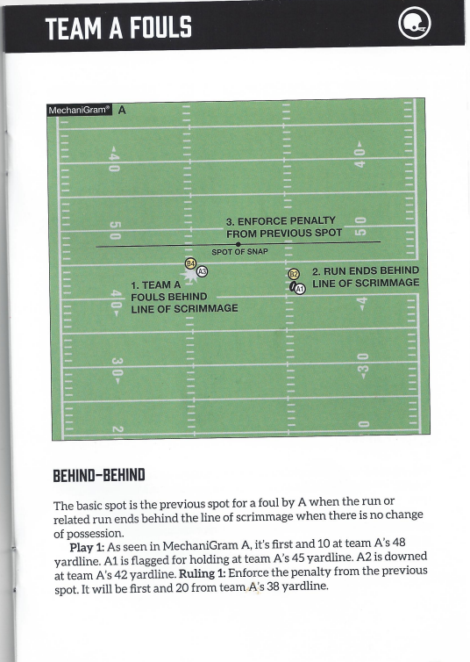
TEAM A FOULS BEHIND THE LINE OF SCRIMMAGE AND THE RUN ENDS BEHIND THE LINE OF SCRIMMAGE
ENFORCEMENT SPOT: PREVIOUS SPOT

Slide 4
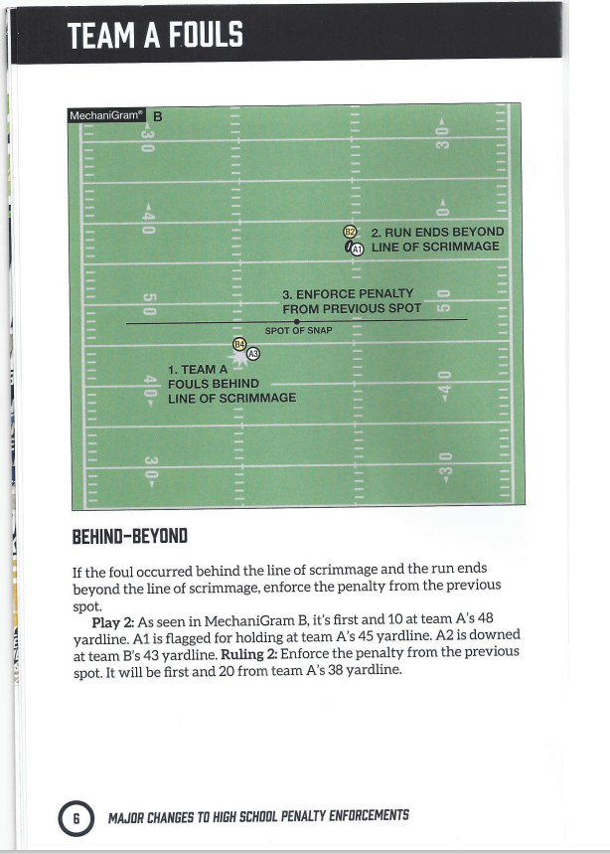
TEAM A FOULS BEHIND THE LINE OF SCRIMMAGE AND THE RUN ENDS BEYOND THE LINE OF SCRIMMAGE
ENFORCEMENT SPOT: PREVIOUS SPOT

Slide 5
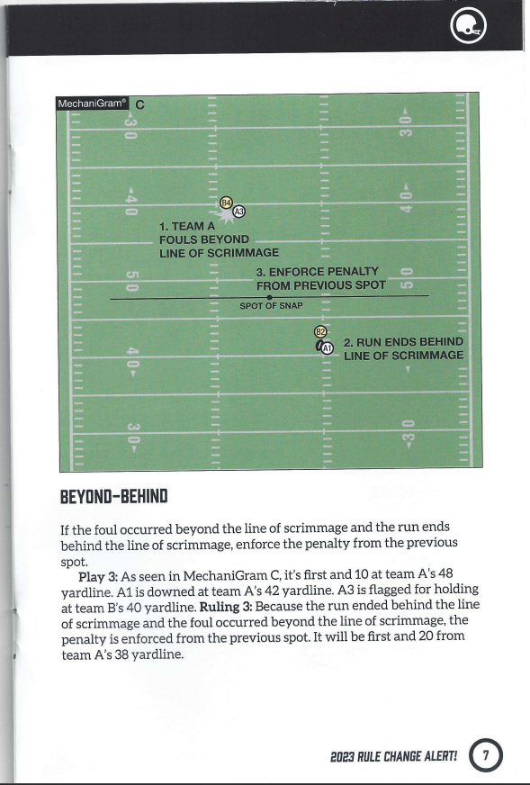
TEAM A FOULS BEYOND THE LINE OF SCRIMMAGE AND THE RUN ENDS BEHIND THE LINE OF SCRIMMAGE
ENFORCEMENT SPOT: PREVIOUS SPOT

Slide 6
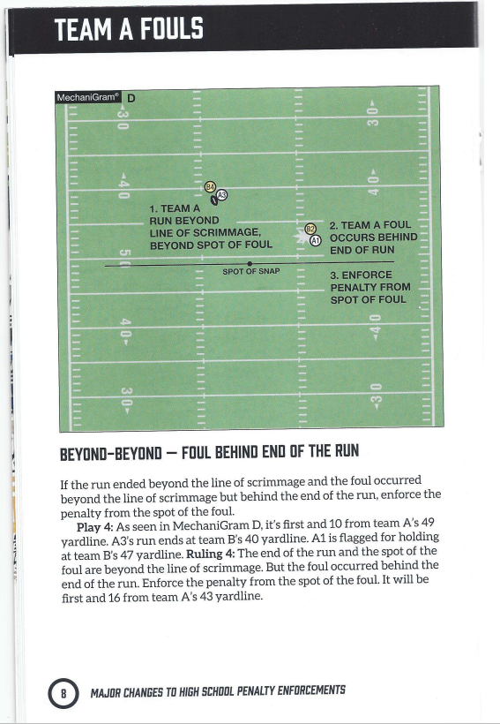
TEAM A FOULS BEYOND THE LINE OF SCRIMMAGE, BUT BEHIND END OF RUN AND THE RUN ENDS BEYOND THE LINE OF SCRIMMAGE
ENFORCEMENT SPOT: SPOT OF FOUL

Slide 7
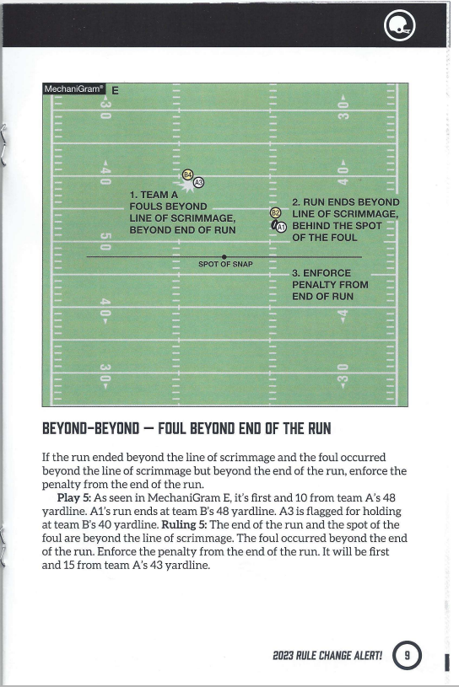
TEAM A FOULS BEYOND THE LINE OF SCRIMMAGE, BUT BEYOND THE END OF RUN AND THE RUN ENDS BEYOND THE LINE OF SCRIMMAGE
ENFORCEMENT SPOT: END OF RUN

Slide 8
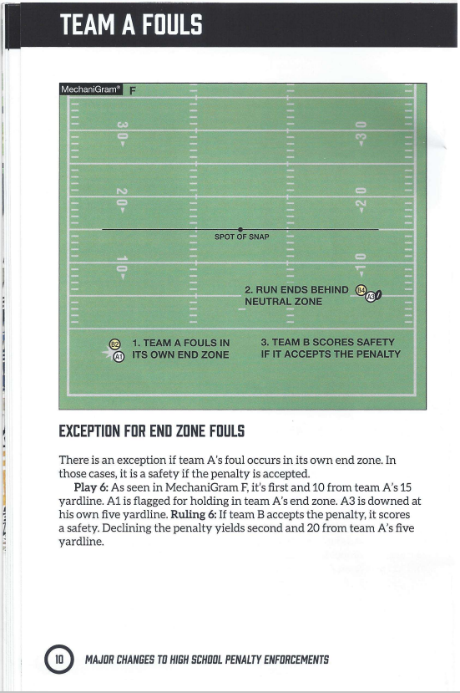
EXCEPTION FOR END ZONE FOULS
TEAM A FOULS OCCURS IN ITS OWN END ZONE AND RUN ENDS BEHIND OR BEYOND LINE OF SCRIMMAGE
ENFORCEMENT SPOT: SPOT OF FOUL
AND TEAM B SCORES A SAFETY

Slide 9
READ YOUR RULE BOOKS AND STUDY THE MECHANICS FOR THE POSITION YOU ARE ASSIGNED TO WORK.

Slide 10
10 Lessons of Leadership & Wearing the White Hat
Additional questions/concerns, contact:
Johnny Wilson
Phone: 770-597-6485
Email: jawils07@comcast.net
Cedric Cooper
Phone: 404-593-6921
Email: cedcooper@gmail.com
Referee Essentials

